Slide 1
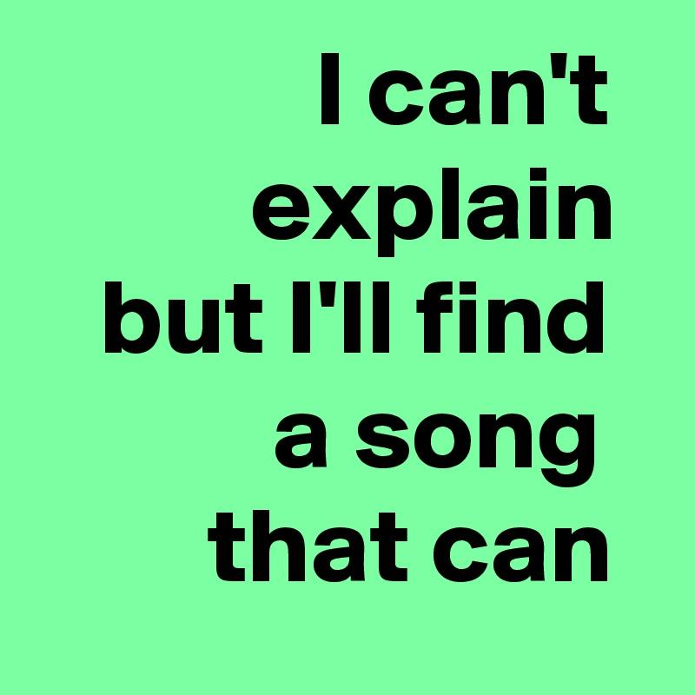
Music Analysis using Machine Learning
Team 1: Derek Grubis, Gopalika Sharma, Surya Menon
Notes:
Hi, we’re Team 1, and our final project is music analysis using machine learning

Slide 2


Let’s Dance to the tunes with ML...
Problem Description
Improve a user’s experience in music selection
Classification of song genre, mood, and popularity
Precursor to designing more effective recommendation systems
Notes:
SURYA
We are looking at whether we can better understand a user’s music selection process and whether we can improve a person’s experience when making song choices through classification of song genre, mood, and popularity. When cultivating a playlist, users may be categorizing tracks with regards to these 3 factors. Essentially, better understanding what aspects contribute to a person’s enjoyment of music could help in designing more effective recommendation systems.

Slide 3

Spotify Tracks DB
Tracks taken from the Spotify API containing metadata and audio features including:
genre
Hip-Hop, Rock, Reggae
popularity (0 to 100)
valence (0 to 1)
loudness (-60 to 0 dB)
duration (ms)
232,725 songs
18 variables
Dataset link: https://www.kaggle.com/zaheenhamidani/ultimate-spotify-tracks-db
Notes:
SURYA
To accomplish our tasks, we utilized the Spotify Tracks dataset, which contains track information and audio features for songs available on Spotify. This particular subset contains over 200,000 records (or songs), with 18 variables. Variables include song metadata (such as artist_name, track_id, track_name) and audio characteristics (such as the track key, tempo, and time signature). The 3 variables related to our response variables are popularity, which ranges between 0 and 100), genre (which is made of 26 classes), and valence (which is a measure of musical positiveness from 0 to 1).

Slide 4

Exploratory Data Analysis
“Talking about music is like dancing about architecture.”
Steve Martin

Slide 5
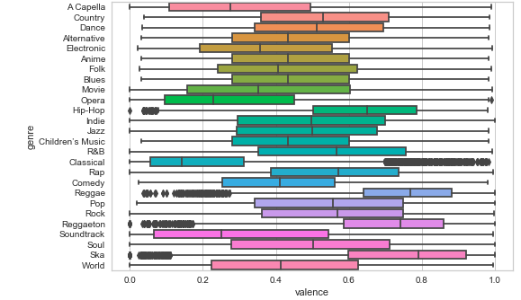
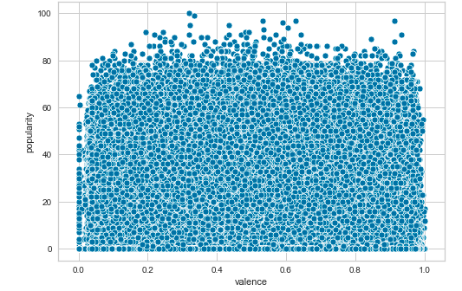
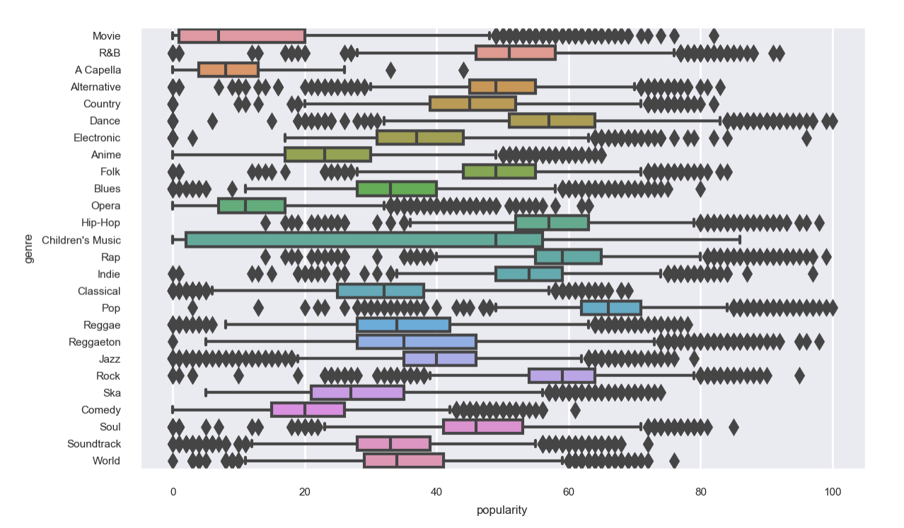
Song Valence by Genre Boxplots
Popularity vs Valance
Song Popularity by Genre Boxplots
Notes:
GOPALIKA
Before any processing of our database we tried to visualise our data and tried to understand how to features respond to one another and to the three stumps of our project which is popularity, mood and genre.
SO our next step was to see how the three bases, our genre, popularity and mood come together. So a box plot was constructed with the mood indicator which is the valence with respect to genre and we discovered startling discoveries like Ska followed by Reggae is the most positive music and not classical which was plotted far behind as it is deemed to be one of the most positive music genres. We tried to plot the popularity with the valence and drew a conclusion that the most popular songs are usually the most negative songs or the songs with the lowest valence value.
Last but not the least we put together genre and popularity as we realised that pop is the most popular genre in the world right now.

Slide 6
Model Preprocessing
Processing:
Standardization
One-hot encoding
New Metrics:
Popularity
Mood
Reduced genre feature
Feature Selection:
Filtering
Regularization
Notes:
DEREK
For our general preprocessing strategy we all applied to our data, we also scaled the data using Standard Scalar and employed one-hot encoding on categorical measures (genre, key, etc). For each of the different models, we employed filtering and regularization methods.

Slide 7
Song Popularity
1
“A Khaled record is always the best.”
DJ Khaled
Notes:
So the first task was predicting song popularity. The original popularity measure in the dataset is a continuous measure (from 0 to 100), with 100 meaning the most popular when rating a track. This measure is in part based off of the total number of plays the song has on Spotify. For our classification task, we created a binary popularity metric, which used 50 (or the midpoint) as the threshold of rating a song as popular or not.

Slide 8
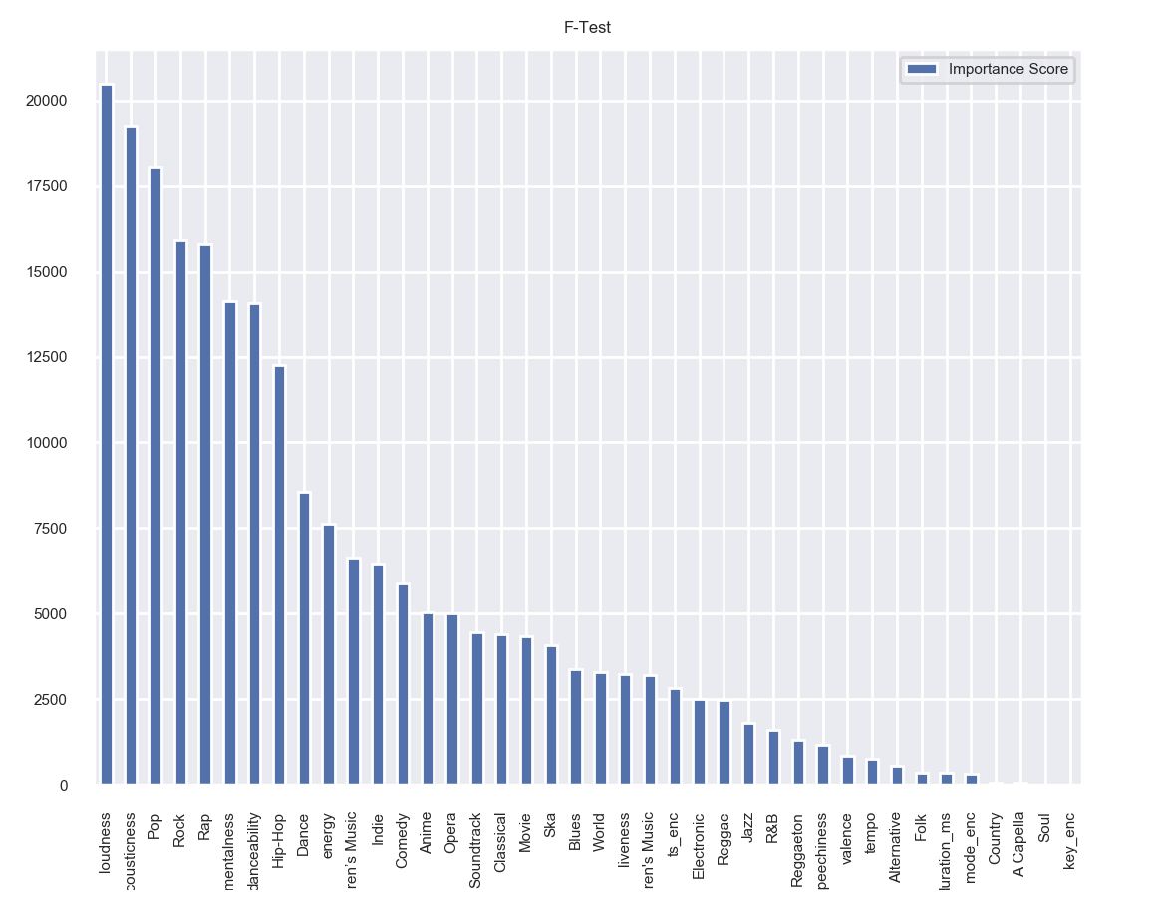
Logistic Regression
F-Test filtering
Feature subset:
loudness
acousticness
genres: Pop, Rock, Rap, Hip-Hop, Dance
instrumentalness
danceability
Notes:
We first fit a logistic regression model. We initially fit a model on the full feature set, and we were able to get a test accuracy of about 0.75. We then performed filtering using different statistical criteria (including correlation, mutual information, and F-test) and compared the difference performances. We determined that using F-score metrics (which is a ratio of the variances) let to substantial model improvements, and our final model included the predictors loudness, acousticness, instrumentalness, danceability, and the genres Pop, Rock, Rap, Hip-Hop and Dance. We implemented a model with L2 regularization but did not observe substantive improvements.

Slide 9
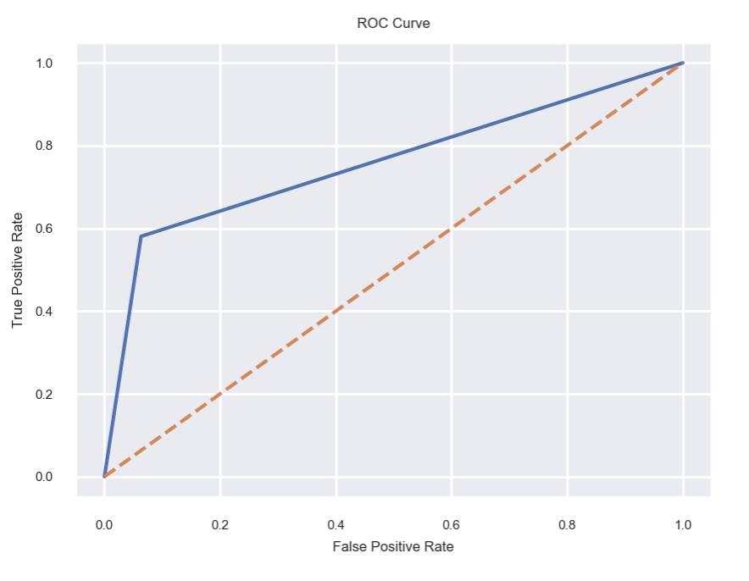
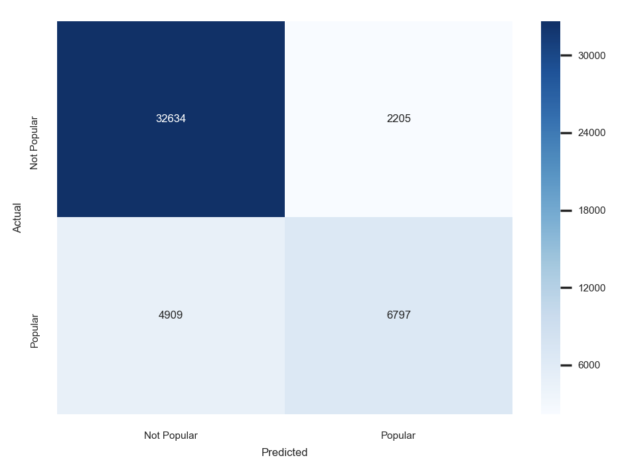
Metrics
Test Accuracy | 0.847
Test Precision | 0.756
Test Recall | 0.581
AUC | 0.759
Cross-validation (5-fold) Accuracy | 0.844
Notes:
So our final model with the feature subset has a test accuracy of about 85%, with a precision of 75.6% and a recall of 58.1%. So the model has a somewhat reasonable rate in correctly predicting popular songs, and a pretty low rate in identifying all actually popular songs. We see the AUC value is 0.76, which is better than random.

Slide 10
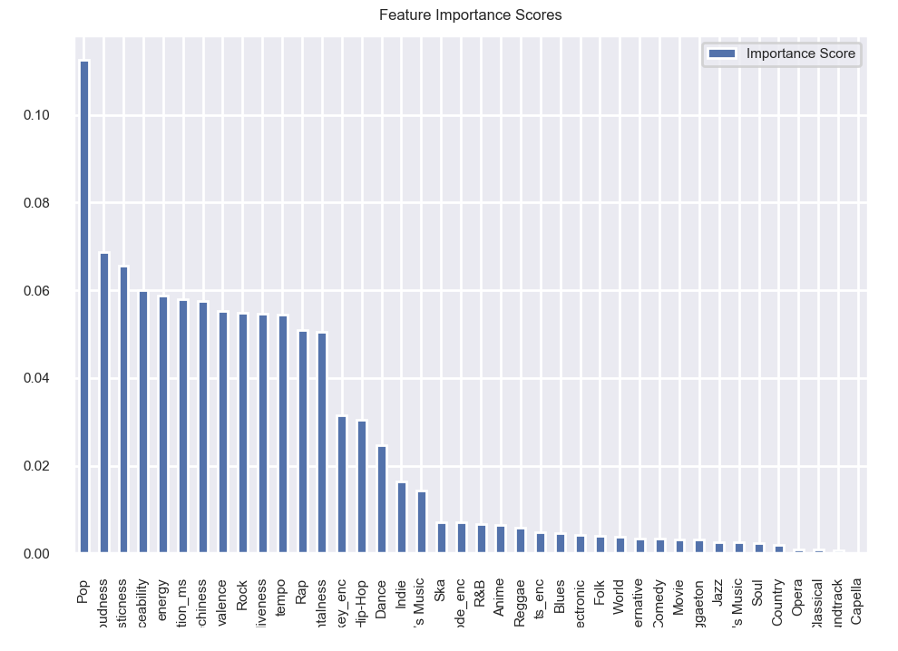
Random Forest
Full feature model
Variable Importance
Feature subset:
loudness
acousticness
energy
duration
speechiness
valence
Pop
instrumentalness
danceability
Notes:
Next we fit a random forest model to predict popularity. We first fit a full model and got a test accuracy of 0.828. We then create a variable importance plot (using a Gini impurity metric), to identify the variables that contribute the most to the prediction. After testing a combination of subsets based on these results, we identify loudness, acousticness, energy, danceabilty, duration, speechiness, valence and the Pop genre as the best subset. We conducted some hyperparameter tuning (using cross validation) to assess the maximum number of estimators and maximum tree depth.

Slide 11
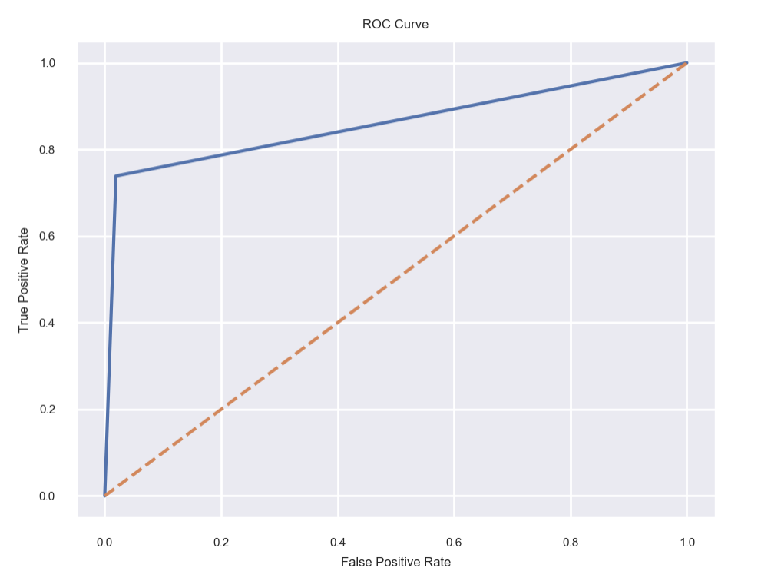
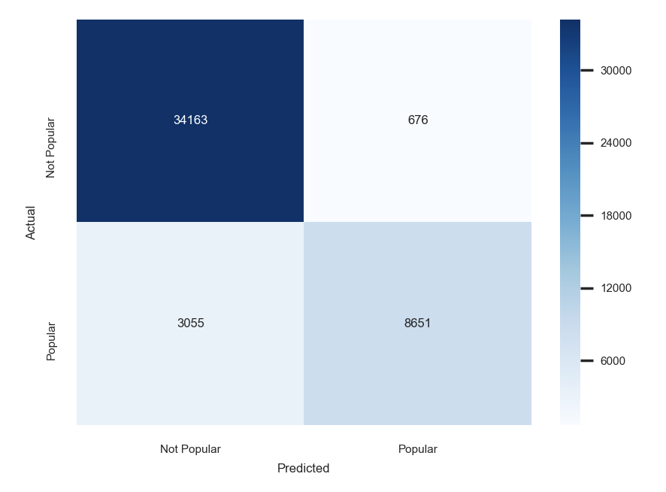
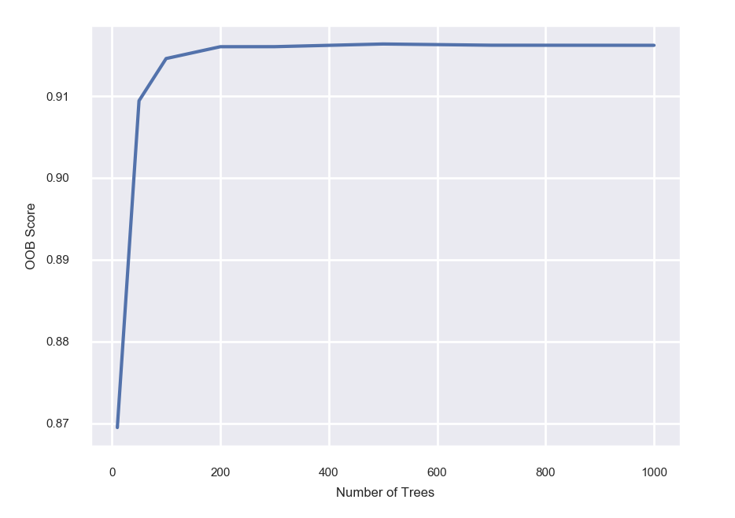
Metrics
Test Accuracy | 0.92
Test Precision | 0.928
Test Recall | 0.739
AUC | 0.86
OOB Accuracy | 0.914
Notes:
We found that the model continued to improve when increasing maximum tree depth so in our final model we did not limit the growth; we also saw when plotting the out-of-bag accuracy that the score levels off (with minimal increase) after 100 estimators, so we kept our estimators to 100 trees. Our final model has an increased test accuracy (of 92%), precision (93%), and recall (74%). Additionally we observe that our random forest model has an improved ROC curve and AUC value of 0.86.

Slide 12
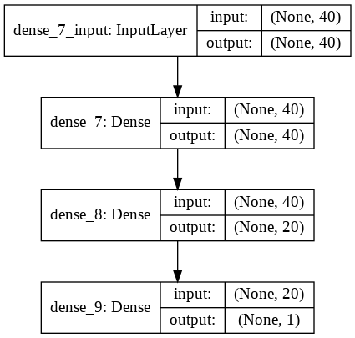
Neural Network
Feed-forward network
reLU activation
Final sigmoid activation
Final architecture:
2 hidden layers
Parameter tuning
Notes:
Finally we attempted to fit a feed-forward neural network predictive model, using the full feature set. We experimented with various hyperparameter, including number of hidden layers, neurons per hidden layer, epochs, batch size, and learning rate; however we found that we did not really observe significant differences in our metric results. We additionally attempted to include Dropout layers (varying between 0.2 and 0.5), but we again did not find substantial improvements to our results. Our final model included 2 hidden layers (with 40 and 20 neurons respectively), followed by sigmoid activation. We did not train beyond 5 epochs, because we found that little improvement after this point.

Slide 13
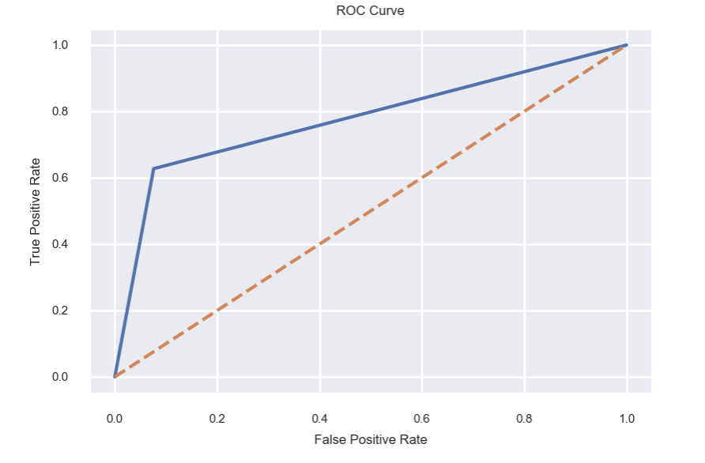
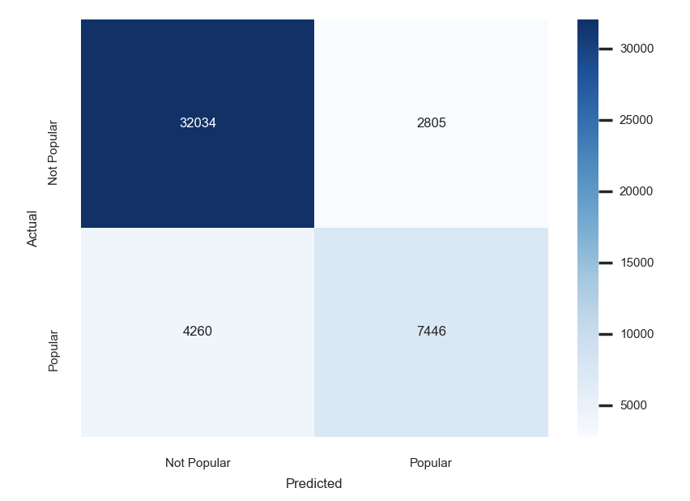
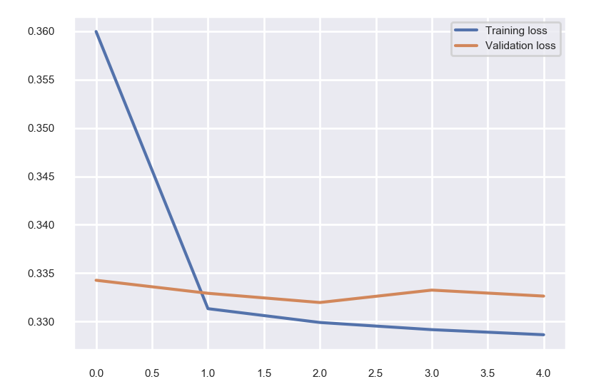
Metrics
Test Accuracy | 0.849
Test Precision | 0.735
Test Recall | 0.627
AUC | 0.776
Cross-validation (5-fold) Accuracy | 0.846
Notes:
We see that our final model results are not much better than logistic regression. The test accuracy (at about 85%) and precision scores are similar, with slightly higher recall at 62%. When plotting validation loss, we see that model stops improving relatively quickly (at around the 2nd or 3rd epoch). The AUC score is 0.776, which again is only marginally better than our logistic regression results. The results indicate that perhaps additional hyperparameter tuning and more data is necessary to get substantive improvements to this model.
So overall, for predicting song popularity, we were able to get the best results using a random forest ensemble.

Slide 14
Song Mood
2
“Music is the shorthand of emotion.”
Leo Tolstoy
Notes:
“Do I listen to pop music because I’m miserable or am I miserable because listen to pop music?” — John Cusack

Slide 15
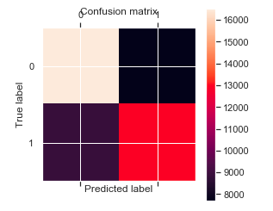
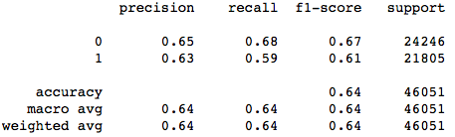
Logistic and Linear Regression
Target Variable : Valence
Modified Target Variable : Mood
0- Negative ; 1- Positive
Linear Regression
MSE : 0.04
Logistic Regression
Accuracy: 63%
Notes:
We first tried to fit a linear regression model as our target variable Valence was continuous, we received a perfect fit with a lower MSE value of 0.04 which is substantial enough to say was a good fit. Although there is so much you can do with a continuous variable and also it did not help in the classification of the tracks in positive or negative music, hence with one-hot bit encoding, we put a threshold value to our target variable by calculating the mean of the column which was 0.5 , hence songs lower than this value were given the place holder for negative songs and the others were classified as positive tracks.
We fit a logistic regression model to achieve an accuracy of 63 % over all. Lets have the look at the confusion matrix to understand the metrics generated her.

Slide 16
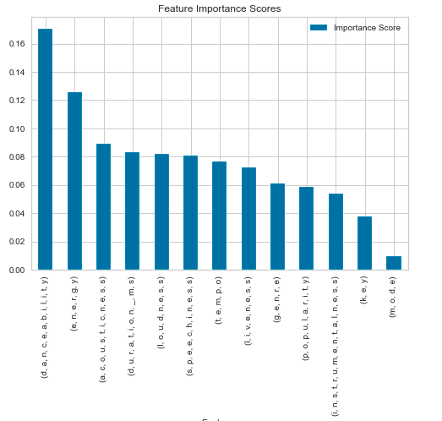
Random Forest Regressor
For training set with respect to the validation set: For testing set with respect to the full feature set:
R-square | OOB Score | R-square Validation Score
0.93 | 0.50 | 0.51
R-square | OOB Score | R-square Validation Score
0.92 | 0.41 | 0.51
Notes:
Feature Importance graph - Danceability holds the highest value for valence but there are a lot of other variables which equally affect the valence variable hence cannot be put out or less considered.
Well, there is some overfitting in the model, as it performs much worse on OOB sample and worse on the validation set, hence we move further with our modelling.

Slide 17
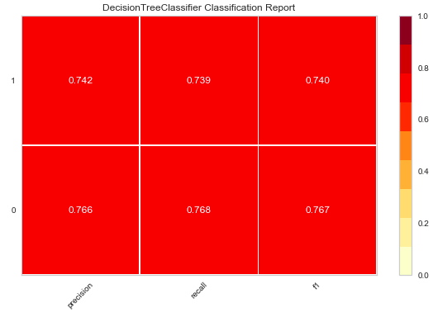
Decision Trees
Accuracy | 75%
Error | 25%
Notes:
Not satisfied with LOG REG , we tried to fit a decision tree model which definitely gave us better accuracy than the last model, but there is always a scope for improvement. Lets have a look at the metric graph constructed using the yellowbrick package in python.

Slide 18
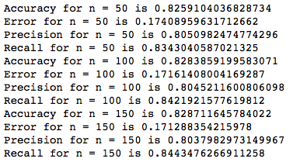
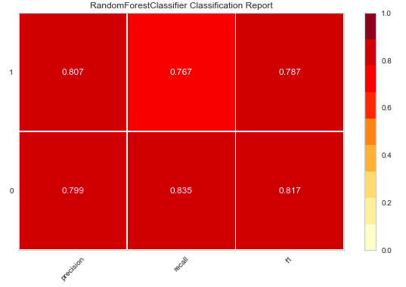
Random Forest
Notes:
After not having achieved a better accuracy with Logistic Regression and DT, we tried to fit a random forest with our given dataset and the new modified target variable “mood” , we tried to run the model on an increasing set of base estimators to whether the accuracy increases with the number and so was the case. Lets have a look at the metric graph constructed using the yellowbrick package in python.

Slide 19
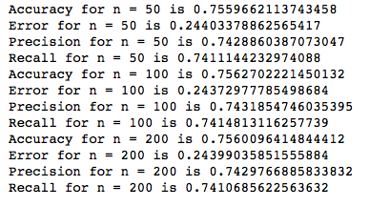
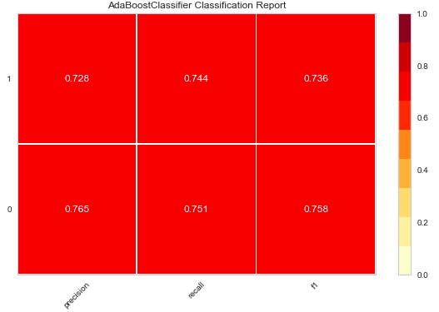
AdaBoost Algorithm
Notes:
Well there is no harm in trying more so we pushed ourselves to fit an adaboost algorithm with a varying range of estimators with our base estimator being DT but not much difference was perceived in the accuracy value. Let’s have a look at the metrics graph.

Slide 20
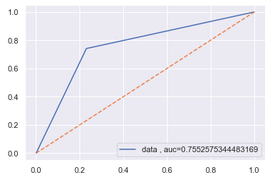
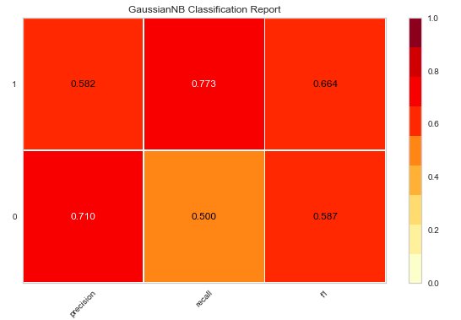
Naive Bayes
Accuracy | 63%
Error | 27%
Notes:
Last but not the least, NB model was our last fit and did not give us satisfactory results as the accuracy value lied in the lower 60s with the LOG REG. Also when you see the metric graph it has disappointing results, (read from the graph)

Slide 21
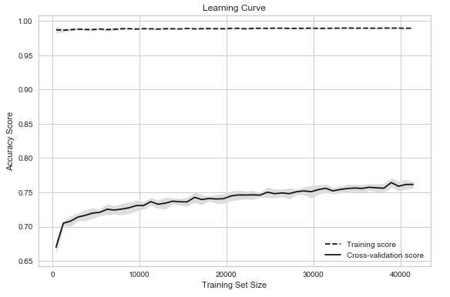
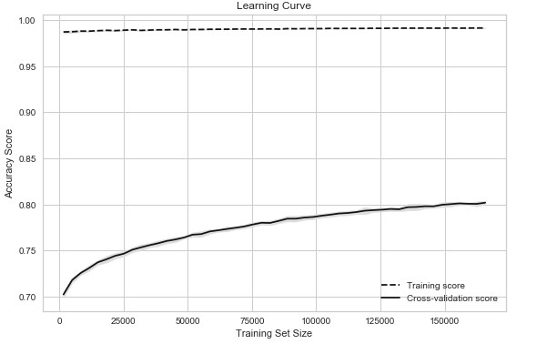
Random Forest: (BEST MODEL FOR MOOD)
Training Curves
Notes:
After having plotted a hoard of models we arrived at a conclusion that Random Forest ensemble was the best model with the highest accuracy value of 84% ,average of all the base estimator values put together. Hence, the learning curve for the model was plotted for the training and the testing sets. The cross validated score was reported with the testing dataset doing a little better than the training dataset and we decided to keep this ensemble for our mood classifier.

Slide 22
Song Genre
3
“I hate the idea of genres.”
Billie Eilish
Notes:
Our final task was to build a classifier that can automatically tag a song’s genre. This in turn is a multi-class classification problem. For simplicity we shrunk the space of genres from 26 down to 10. (Pop, Rap, Rock, Country, EDM, Reggae, R&B, Jazz, Indie and Classifical). And as this quote foreshadows how difficult this task is.

Slide 23
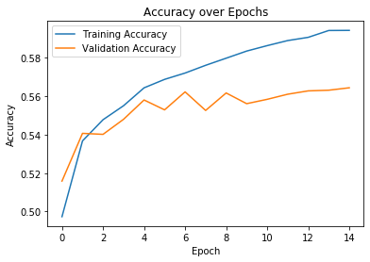
Neural Network
Feed-forward network
reLU activation
Final softmax activation
Final architecture:
Input layer:
30 neurons
1st hidden layer:
1000 neurons
2nd hidden layer:
700 neurons
0.35 dropout rate
3rd hidden layer
250 neurons
0.15 dropout rate
Output Layer
10 neurons
Notes:
The first model we built was a neural network as we were drawn to the softmax activation in the output given our multi-class approach. After tuning trying to find optimal parameters we were left with an architecture of 30 features as our input layer, 3 hidden layers of 1000, 700 and 250 neurons respectively with a 35 percent dropout rate in the 2nd hidden layer and 15 percent dropout rate in the 3rd layer. Adding this dropout regularization boosted performance pretty well on the test and validation error. All hidden layers used relu with the final output layer using softmax for our 10 genres. We can then see how the network trained. The training error keeps increasing whereas the validation error is rocky for the middle epochs before smoothing out to a convergence after 9 epochs. The accuracy appears pretty low but given a random model would be expected to give 10% accuracy this does pretty well in comparison and is in line with other results we’ve seen to similar attempts at this problem.

Slide 24
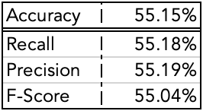
Gaussian Kernel SVM
Gaussian (or RBF) Kernel SVM performed better than Linear SVM
Tuning C and gamma through cross-validation and grid search proved too expensive
Optimal C = 3
Too large => too much bias
Too small => overfitting
Notes:
Next we trained a support vector machine. We tried both a Linear SVM and gaussian (or RBF) Kernel SVM with the Gaussian Kernel performed better giving us insight into the non-linearity of our data. So we needed to tune our hyperparameters specifically in this case our C and gamma values. We tried to find these parameters through cross-validation and grid search but that proved to be too expensive of an operation given our current resources. We were still able to get good results compared to the softmax neural network from manually tuning these hyperparameters. We found a C of 3 was pretty optimal as it wasn’t too large to introduce too much bias but not too small to create an overfitting model. The accuracy, recall, precision and F-score were all remarkably balanced at 55% showing the model performs the same identifying a genre as that genre as well as correctly predicting the right genre out of possible genres

Slide 25
Conclusions
We looked to improve a user’s experience on an app like Spotify or Apple Music
Predicting Song Popularity
Mood Based Classifier
Automatic Genre Tagging
Achieved through a host of machine learning algorithms
Neural Network
Random Forest
AdaBoost
Kernel SVM
etc.
Notes:
DEREK

Slide 26
Credits
Special thanks to the people who made this project possible:
Professor Alina Oprea
Yuxuan (Ewen) Wang

Slide 27
Thanks!
Any questions ?

Slide 28
References
Song Popularity
Song Mood
Song Genre
Automatic Tagging of Songs:
http://article.nadiapub.com/IJDTA/vol9_no5/13.pdf
This is a paper that used various machine learning algorithms to classify the genre of a song. The authors used the million song dataset.
Song Popularity Predictor:
https://towardsdatascience.com/song-popularity-predictor-1ef69735e380
This tutorial goes over a procedure used to create a popularity predictor using the Million Song Dataset (MSD) and BillBoard Top 100 information to replace the missing popularity data.
Predicting Song Popularity: http://cs229.stanford.edu/proj2015/140_report.pdf
An academic paper from Stanford discussing song popularity prediction models using the MSD. Provides information on both classification and regression models implemented.
Music Mood Classifier:
https://github.com/rasbt/musicmood/tree/c942e2592ccc1b092d950a5cd3c9050419728a6a
This project is about building a music recommendation system for users who want to listen to happy songs.
Music Mood : Predicting the mood of music from song lyrics using Machine Learning
https://arxiv.org/pdf/1611.00138.pdf
This is a full fledged paper written by Sebastian Raschka that is being used a guide book and we are basing our work on this as it has a detailed description on how music is corresponding to a happy mood and it can be detected with high precision based on text features obtained from song lyrics.
Notes:
More references included in final paper

